Slide 1

Assignment4: Health Industry
Yihan Huang

Slide 2
Part1 Literature Review

Slide 3
1.1 Versatility and Scalability: Broad Applications and Consistent Measurements
1. Versatility: Highlight the model's core methodology that can be adopted across various areas in healthcare and potentially other industries.
2. Scalability: Emphasize how the model ensures consistent risk measurements across domains, promoting comparability in risk assessments across different healthcare areas.

Slide 4
1.2 User Customization and Cost-Effective Fraud Detection: Personalization and Efficiency
1. User Customization: Discuss the possibility of user customization which allows users to specify the domains they want to work on and tailor the analysis to their specific needs and priorities.
2. Cost-Effective Fraud Detection: Highlight the focus on cost-effective fraud detection models and how the approach can be extended beyond prescription fraud for efficient detection in different healthcare practices.

Slide 5
Part2 Assignment 4

Slide 6
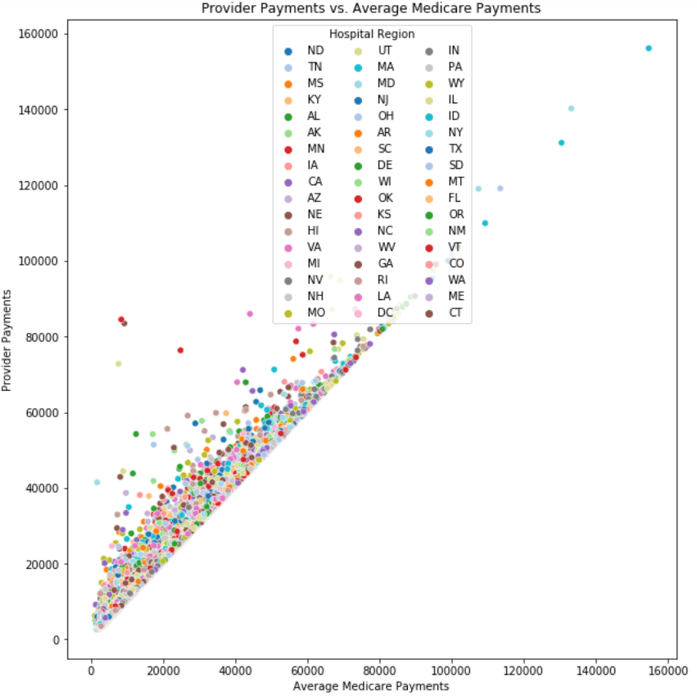
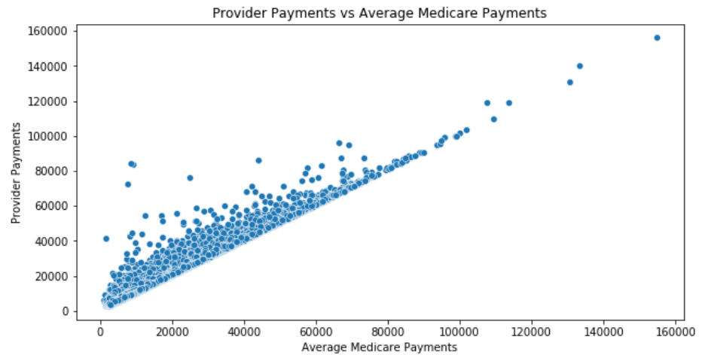

Slide 7
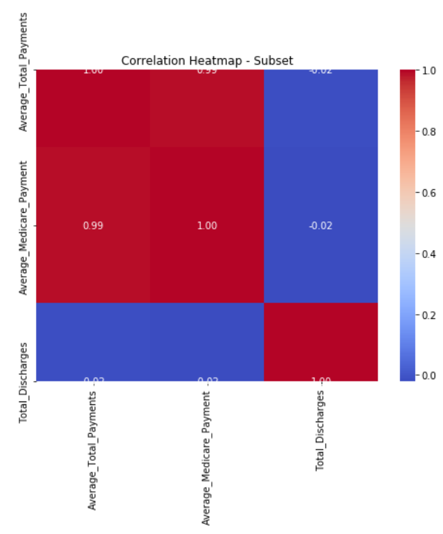
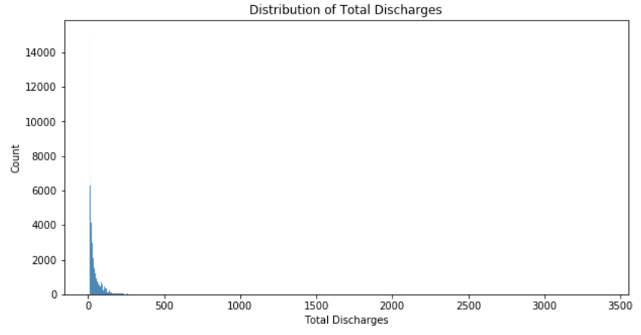

Slide 8
Feature Engineering Summary 1
Statewise Average Discharge
Reflects general hospital discharge rates per state
Not a benchmark as discharge rates can be affected by external factors
DRG Average Medicare Payment
Reflects the costliness of each DRG from Medicare's perspective
Not a benchmark as it doesn't consider individual provider costs or patient outcomes
Citywise Average Total Payments
Shows the average cost of healthcare in each city
Not a benchmark as prices can fluctuate due to factors like location and patient demographics
Provider Payment Difference
Indicates whether a provider's charges are above the state average
Not a benchmark as higher costs could reflect higher quality care or more complex cases
DRG Payment Ratio
Shows if a provider charges more for a DRG than the average
Not a benchmark because a higher ratio could be due to treating more complex cases

Slide 9
Feature Engineering Summary 2
DRG Count in State
1. Represents the number of times a DRG occurs in each state
2. Not a benchmark, but provides insight into the prevalence of specific procedures
Citywise Average Medicare Payment
1. The average Medicare payment in each city
2. Not a benchmark because it varies by city
Statewise Max Total Payments
1. Represents the maximum average total payments for each state
2.Not a benchmark as it's specific to each state
DRGwise Min Medicare Payment
1. The minimum average Medicare payment for each DRG
2. Not a benchmark as it's specific to each DRG
Hospital Service Volume
1.The total number of discharges for each hospital
2. Not a benchmark, but provides an overview of the hospital's service volume
11. Payment Difference from City Average
1. The difference between a specific payment and the average total payment for that city
2. Not a benchmark as it's specific to each payment and city

Slide 10
Thank You!
Happiness is a warm puppy

Slide 11

Dogs
Dogs need to feel active and go for a walk with their owners, but what can we do if we aren’t able to walk our dogs as much as we’d like to? Stay with us...

Slide 12
2. Provider Attributes
Population_of_Provider_County
Provider_State
Provider_County
The state in which the healthcare provider is located.
This is the population of the county where the healthcare provider is located.
The county in which the healthcare provider is located.

Slide 13
Table of Contents
The Dogs
Training
Games
Advices
How much do you love your pet?
Teach your friend new tricks
Play and have fun together
Some tips on good pet care

Slide 14
—M.K. Clinton
“The world would be a nicer place if everyone had the ability to love as unconditionally as a dog.”

Slide 15
33%
of the world’s households have pet dogs

Slide 16
Highest Amount of Pet Dogs
Argentina, Mexico and Brazil are the countries with the highest amount of pet dogs per house

Slide 17
Two Realities
Adoptions
Abandonment
During this period of lockdown, the amount of dog adoptions has greatly increased
Unfortunately, there are also abandoned dogs due to owners not being able to take care of them

Slide 18
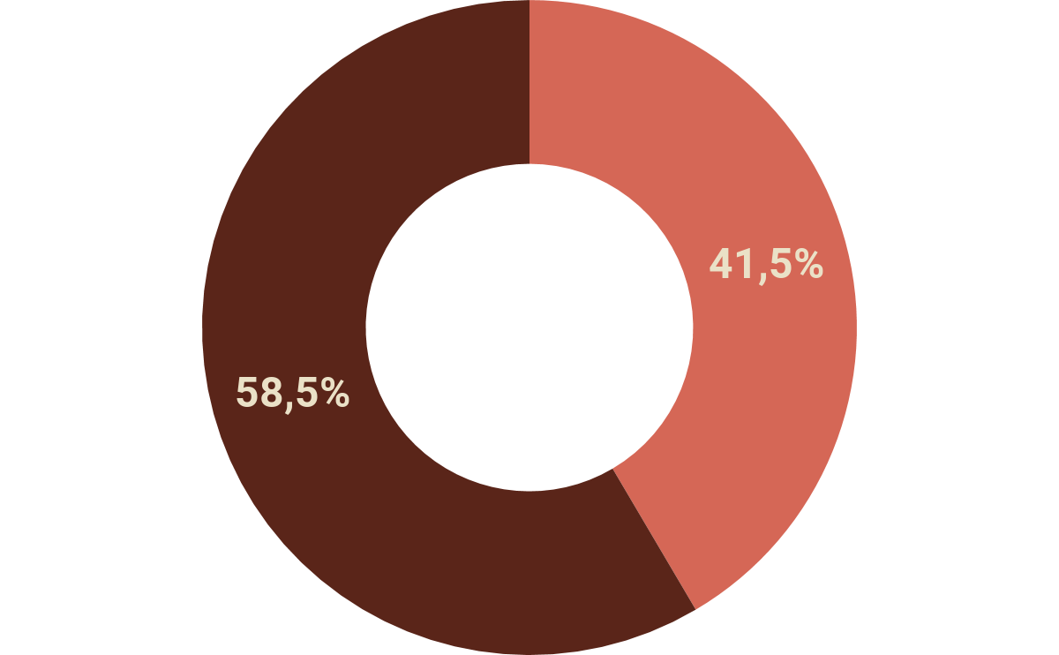
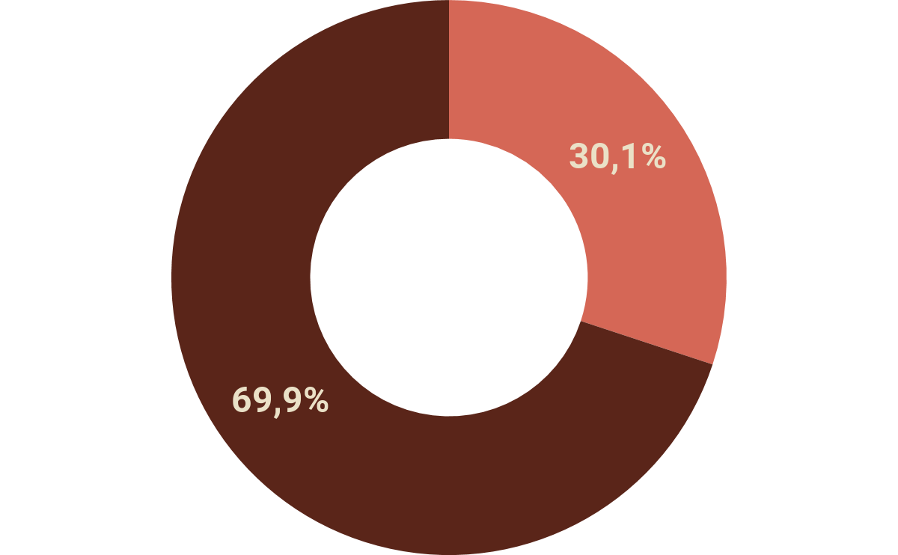
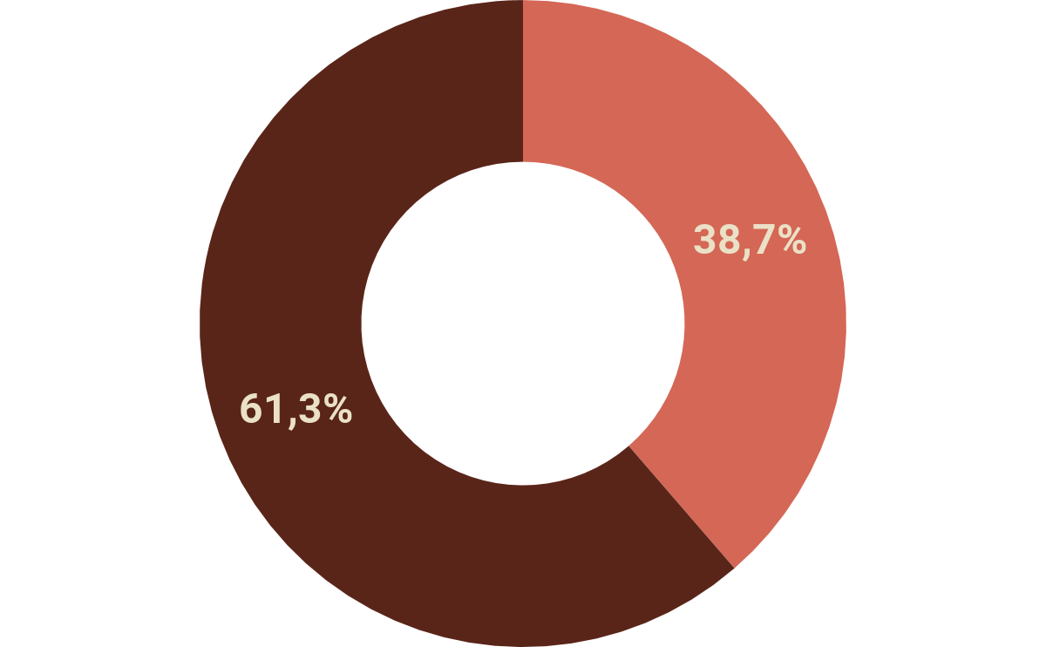
Dogs and the Lockdown
Stress
Lower Defenses
Misbehavior
Your dog most likely won’t understand why it must stay at home for so long. Vets recommend playing with them so they can spend some energy. Otherwise, they could suffer from:

Slide 19
500M
30min
3 times
dogs in the entire world
is the average duration of a walk
A day, take your dog for a walk

Slide 20

My Heart Is Full of Footprints

Slide 21
Basic Training...
1
2
3
Clicker
Name
Food
You can teach your dog that the sound of a clicker means a reward
Reward your dog whenever it answers to your calling
Make your dog follow the food when placing it in front of its nose

Slide 22
… For Your Dog
4
5
6
Call
Patience
Sit
Try to use words such as “come” and reward your dog if it obeys
Put a snack close to its nose and see if the dog tries to get the treat
Walk beside a snack and give it to your dog if it sits down

Slide 23

Games
Some entertaining games:
sniffing, gnawing, thinking

Slide 24
Classic Games
Catch!
Fetch!
Water!
Throw a ball and let your dog catch it!
Toss an object and let your dog fetch it
Some dogs love water and being bathed

Slide 25

2. Hide-and-Seek
Play hide-and-seek with your dog to strengthen your emotional bonds:
Someone else keeps the dog distracted
Hide in a room or corner
The person with the dog says ‘come on, go find (your name)!’
Your dog tries to find you
Be sure to make it a big deal and reward your dog with a treat or pet it
You can change the game difficulty if your dog gets used to the game

Slide 26
3. Find It!
Part 1
Part 2
Part 3
Classic
Heights
In the Dark
Show your dog a piece of food or a treat
Hide it somewhere and say ‘find it!’
Show the piece of food or treat
Hide it at a different level and say ‘find it!’
Show the piece of food or treat
Hide it somewhere, turn the lights off and say ‘find it!’

Slide 27
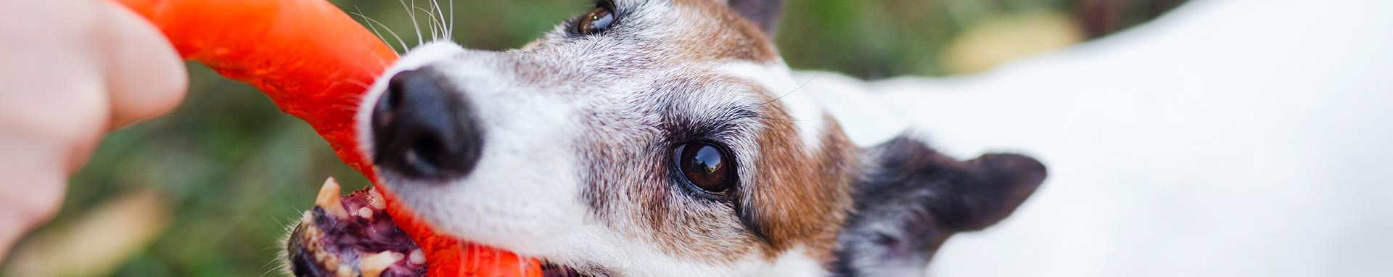
4. Tug-of-War
1
2
3
4
Grab a towel and tie some knots
Show the new towel-toy to your dog
Hold it firmly when your dog bites it
Keep playing until your dog gets tired

Slide 28
5. Agility Course
Obstacle courses for dogs are great for them. It’s good physical and mental exercise for your dog, and it keeps them entertained. You can also use them to teach your dog how to react to words such as “jump”, “roll” or “stop”. There are agility-course kits for sale at pet shops, but it’s more fun if you make your own course at home with:
Stool (to jump over it)
Chairs (to jump over them or pass underneath them)
Open cardboard boxes (to be used as tunnels)
Stick (to jump over it)
Maze with cardboard boxes (for small dogs)
Board (to cross between chairs)
Ramp (to go up)
Ball (to push it)
Hula-hoop (to go through it)
Don’t forget to give some treats to your dog!

Slide 29

6. Relax Time
Music therapy
The blanket
Doga
Using music as a mental stimulation to reduce stress levels
Place a blanket on the floor and pet your dog when it steps on it
Practicing yoga with your dog to strengthen emotional bonds and improve its mood

Slide 30

7. Multimedia
You can watch a movie together (especially if dogs are featured on it), listen to a relaxing playlist (to calm your dog down) or a lively one

Slide 31
8. Apps
Some dogs enjoy technology too! Try downloading on your tablet some game apps for dogs and see how your dog has fun catching bugs

Slide 32

9. Dress up
To have a fun time, you can dress up your dog, take lots of pictures of you two together and share them on social media

Slide 33
Doggy Life
Happiness is a warm puppy

Slide 34



Our Little Team
Aldo
Loqui
Ariel
Has a lot of energy and is a little mischievous
The most loyal and also the shaggiest
Loves to play and is a bit conceited

Slide 35
Some Advice
Training
Games
Relax
Diet
Space
Walk
Teach your dog new tricks and skills
Try different activities to make it stay active
Teach it to relax and keep calm
It’s important to feed your dog properly
Keep an eye on this to avoid detachment
Change your walking route from time to time

Slide 36
How Much Is It?
Food
Leash
€540
€35
Vet
Toys
€300
€85

Slide 37
Tips to Save Money
Natural snacks
Vaccine campaign
Bathe it at home
Home
toys
Shop online
Bulk shopping

Slide 38
Make the Most of Its Time
20%
30%
50%
Active
Awake
Sleeping

Slide 39
The Checklist
 | Mon | Tue | Wed | Thu | Fri | Sat | Sun
Morning walk
Evening walk
Night walk
Food
Playing
Training
Bathing

Slide 40

Going for a Walk during Lockdown
During the lockdown, you can walk your dog, but keep these in mind:
Walk your dog on your own
You mustn’t take more than 10 minutes
Avoid contact with other animals and people
Don’t let your dog touch banisters, doors or papers on the floor
Try different routes
Clean its paws, tail and nose after going for a walk

Slide 41
Woof!
Do you have any questions?
youremail@freepik.com
+91 620 421 838
yourcompany.com
Please keep this slide for attribution.

Slide 42
Alternative Resources
Photos
Cute dog with headphones
Cute small dog sitting
White dog playing with ball and family relaxing on sofa at background
Cute small dog with pink glasses
Young girl playing with her pup
Adorable french bulldog playing with toys
Cute dog with a towel
Cute dog with a costume
Front view cute dog sitting
Front view cute dog sitting
Cute small dog with a hat
Cute little dog with a hat
Close-up woman holding dogs paw
Vectors
Red paws background
Dog icons set

Slide 43
Resources
Did you like the resources on this template? Get them for free at our other websites
Photos
Front view cute dog with copy space
Apricot fawn pug dog with flat face and sad eyes
Loving young couple sitting with their dog on sofa against gray wallpaper
Cute small dog with glasses
Front view young girl playing with her pup
Dog playing in park with toys
Cute small dog sitting in a towel
Cute dog with a costume
Front view cute small dog
Cute little dog with a costume
Front view cute dog with shirt
Cute little dog with a costume
Close-up cute little dog out for a walk
Vectors
Cute dog background
Black dogs icons

Slide 44
Instructions for use
In order to use this template, you must credit Slidesgo by keeping the Thanks slide.
You are allowed to:
- Modify this template.
- Use it for both personal and commercial projects.
You are not allowed to:
- Sublicense, sell or rent any of Slidesgo Content (or a modified version of Slidesgo Content).
- Distribute Slidesgo Content unless it has been expressly authorized by Slidesgo.
- Include Slidesgo Content in an online or offline database or file.
- Offer Slidesgo templates (or modified versions of Slidesgo templates) for download.
- Acquire the copyright of Slidesgo Content.
For more information about editing slides, please read our FAQs or visit Slidesgo School:
https://slidesgo.com/faqs and https://slidesgo.com/slidesgo-school

Slide 45
Fonts & colors used
This presentation has been made using the following fonts:
Comfortaa
(https://fonts.google.com/specimen/Comfortaa)
Muli
(https://fonts.google.com/specimen/Muli)
#eae1c7
#d56756
#9b503f
#5a2519

Slide 46
Use our editable graphic resources...
You can easily resize these resources without losing quality. To change the color, just ungroup the resource and click on the object you want to change. Then, click on the paint bucket and select the color you want. Group the resource again when you’re done.

Slide 49
JANUARY
FEBRUARY
MARCH
APRIL
MAY
JUNE
PHASE 1
Task 1
Task 2
PHASE 2
Task 1
Task 2
JANUARY
FEBRUARY
MARCH
APRIL
PHASE 1
Task 1
Task 2

Slide 52
...and our sets of editable icons
You can resize these icons without losing quality.
You can change the stroke and fill color; just select the icon and click on the paint bucket/pen.
In Google Slides, you can also use Flaticon’s extension, allowing you to customize and add even more icons.

Slide 53
Educational Icons
Medical Icons

Slide 54
Business Icons
Teamwork Icons

Slide 55
Help & Support Icons
Avatar Icons

Slide 56
Creative Process Icons
Performing Arts Icons

Slide 57
Nature Icons

Slide 58
SEO & Marketing Icons

Slide 59


